Slide 1
Sales Dashboard Summary
Designed using Power BI

Slide 2
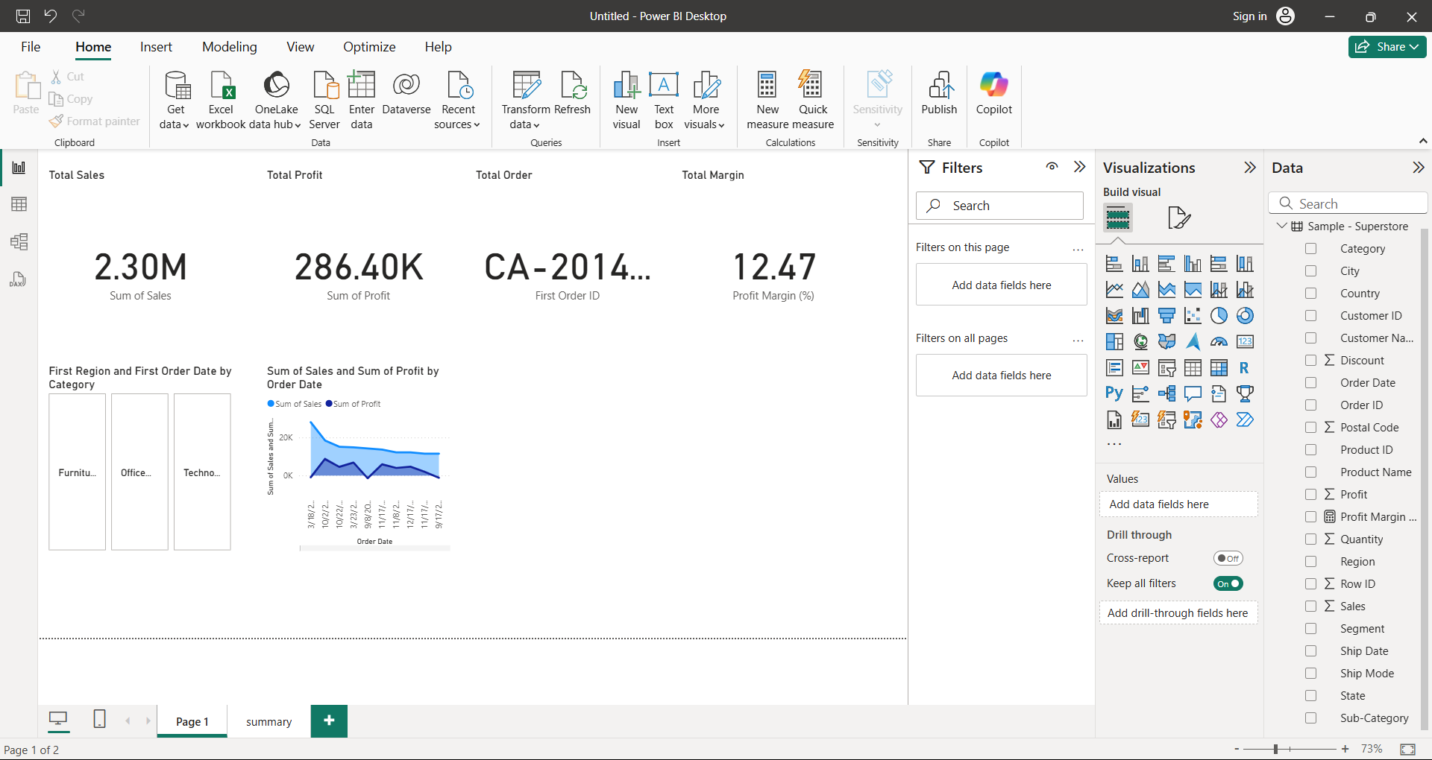

Slide 3
Key Insights
- Sales peaked in Q4 due to holiday demand.
- Office Supplies segment shows lowest profit margin.
- West region contributes highest to total sales.
- Top 10 products account for nearly 35% of total sales.
- Corporate segment generates the most revenue.

